Slide 1
OVERVIEW OF EAC REGIONAL PROGRAMME ACCREDITATION & OBJECTIVES OF THE TRAINING WORKSHOP
Nairobi, May 23rd 2024
Prof. Michael Mawa, Chief Principal
Quality Assurance and Qualifications Framework
mmawa@iucea.org

Slide 2
Presentation Outline
OVERVIEW OF EAC REGIONAL PROGRAMME ACCREDITATION
Introduction
Legal Framework for Regional Programme Accreditation
Rationale for EAC Regional Programme Accreditation
EAC Regional Programme Accreditation Framework, Procedure and Fees
Benefits of Accreditation
OBJECTIVES OF THE TRAINING WORKSHOP
Purpose and Goal
Expected Learning Outcomes
Training Methodology

Slide 3
Introduction
Programme accreditation is globally acknowledged as a major means of recognising and confirming quality.
As a key quality assurance mechanism, programme accreditation is firmly entrenched in QA practices of EAC Partner States by the National Commissions/Council and other accrediting bodies.
A Key feature in this process is the use of prescribed quality standards and criteria.
Since 2006, IUCEA has been developing a regional QA system as part of its mandate to harmonise standards of higher education in the EAC – Roadmap to Quality
From 2020, IUCEA embarked on the development of a framework for regional programme accreditation built on the QA Framework

Slide 4
IUCEA ACT 2009 – Legal basis for Regional Programme Accreditation
SECTION 4(2) b
Contribute in developing Quality Assurance processes in order to ensure that teaching and research achieve and maintain international standards
SECTION 6(c)
The Functions of IUCEA shall be to ensure the establishment of quality assurance through:
the facilitation of harmonised entry standards - EAQFHE;
the development of criteria for assessing standards and assuring the quality of teaching and research through quality assurance mechanisms - evaluation;
promotion, modernisation and harmonisation of university curricula in the Community;
endorsing all approved programmes by accreditation bodies in the Partner States.

Slide 5
Rationale for Regional Programme Accreditation
Two major reasons:
Internationalization of higher education - universities in EAC are increasingly seeking international collaborations - reputation
Demand for international accreditation of programmes by development partners (World Bank)

Slide 6
The EAC Regional Programme Accreditation System
Accreditation is voluntary
Regional Accreditation based on National Accreditation
It is a Quality-Based Programme Accreditation – Quality Seal is issued.
Accreditation based on defined regional accreditation framework.

Slide 7
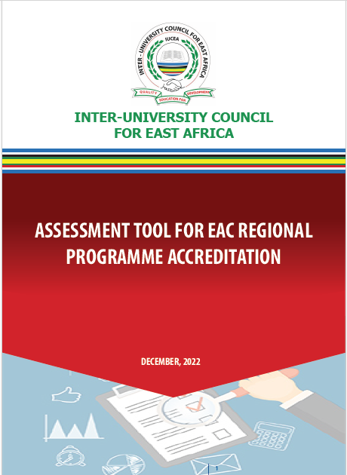
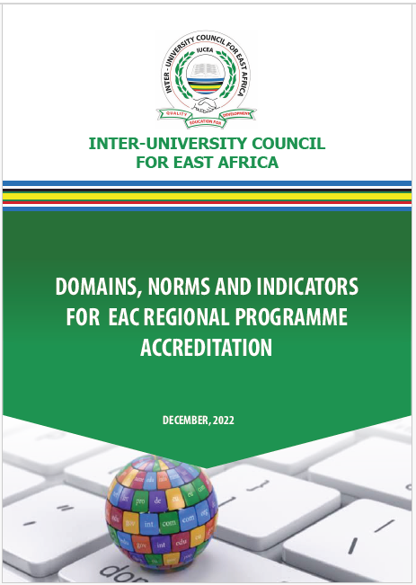
EAC Programme Accreditation Framework
The Framework for EAC Regional Programme Accreditation has now been fully developed.
The framework is defined by the following key elements:
Programme Standards and Guidelines
Programme Domains/Norms
Quality /Capacity Indicators
Programme Assessment Tool
Application Form

Slide 8
Flow Chart for EAC Programme Accreditation
Application
Review
Site Visit
Approval and Declaration
Appeal / Arbitration
Start
Constitution of panel of Experts & Peers
Inform the institution date
Compilation & submission of the report
submit an appeal to the Chairperson.
No objection
Complete the application form
Logistics preparation
Submission of the report to CHEA Committee
Constitute an Ad hoc Committee
Appointment of Expert & Peers
Submit the form
Share the document for review
On site Meeting, interviews, and inspections
Approval and issuance of seal
Review the process, compiles a final report
Submission of individual report
Final results communicated.
Final Decision is communicated
Preliminary/ Administrative Review
Meeting to harmonise the report.
Appr
No
Feedback to applying institutions.
Publication of the accredited programme
End
Response to IUCEA on the action taken.

Slide 9
Programme Accreditation Fees
Payment of requisite initial non-refundable fees of USD 1,000 (for institutions within EAC region) and USD 2,500 (for institutions from outside EAC region) for administrative and technical review of the programme prior to facility verifications/inspection.
Programmes that meet the requirement at review stage shall progress to facility assessment. The institution shall be required to pay a subsidised fee of USD 5,790.
NB: Travel costs for assessors (Air ticket and ground travel) based on market rates shall be met directly by the applying University/Institution

Slide 10
Benefits of the EAC Regional Programme Accreditation
Increased visibility and recognition of EAC higher education institutions/programmes
Improved rating and ranking of EAC HE Institutions
Promotion of mobility of students, staff and resources
Enhanced recognition and legitimacy of the qualifications obtained from EAC
Enhanced quality assurance processes in the HEI

Slide 11
THE TRAINING WORKSHOP

Slide 12
Purpose & Goal of the Training
The Purpose
To equip assessors and programme reviewers with the requisite skills to undertake objective and credible review and assessment of programmes, for EAC regional programme accreditation.
The Goal
To produce a cadre of highly skilled and competent programme reviewers and assessors who can conduct rigorous, objective and effective programme evaluations and assessments for the East African Community.

Slide 13
Expected Learning Outcomes
At the end of the training programme, participants should be able to:
Explain the Standards, Guidelines and Procedures for EAC Programme accreditation.
Conduct effective and objective programme reviews and assessments using appropriate methodologies and tools.
Analyze and interpret data and information gathered during programme assessment process.
Write comprehensive and quality reports and communicate findings and recommendations effectively to key stakeholders.

Slide 14
Methodology of this Training
The training is to be participatory in nature adopting the following approaches:
Presentations;
Sharing of experiences in international programme accreditation;
Brainstorming sessions and Group work;
Practical review of programmes to assess quality.

Slide 15
THANK YOU!

