Slide 1

WB-ROK Scholarship
Application 2025

Slide 2


Overview of the scholarship
WB-ROK Scholarship
Based upon an LOI between WB and ROK Signed
In Feb 2025, the ROK government scholarships,
Global Korea Scholarship(GKS), were extended to
WB’s Partner Universities.
To support inclusive and innovative development in
Higher education by enhancing inter-university
Cooperation and expanding opportunities for
students in higher education institutions

Slide 3

Overview of the Scholarship
Scholarship Program
Quota: Up to 50 scholars per year
Degree Program
1
YEAR
Korean
Language Program
TOPIK
level 3
Doctoral degree: 3 years
Master’s degree: 2 years
* Scholarship duration varies based on the curriculum or
program offered by the University
* Exemptions for the Korean Language Program can be found in the FAQ.

Slide 4
All Scholars
Scholarship Benefits
 | Airfare | Tuition | Korean Language Training Fee | Allowances
Recipient | All Scholars | Scholars in Degree Program | Scholars in Korean Language Program | All Scholars
Benefits | One Round-trip Economy class flight ticket (actual expense) | NIIED and ROK Universities will cover the Tuition | 5.2 million KRW (four quarters) paid directly to language institute to cover training fee | Language Program 14.1 million KRW (about 10,500 USD) per year Graduate Degree Program 15.7 million KRW (about 11,700 USD) per year)
INTERNAL. The allowance amount in USD has been converted using today's exchange rate to assist your understanding, and it may vary depending on the exchange rate.

Slide 5
Programs
Programs (Consisting of departments in various fields established GKS Universities*)
* 74 nationwide – see next slide for Type A and B
Provided by departments at metropolitan(Type A) and regional universities(Type B)
Various majors such as humanities, social studies, natural sciences, arts and athletics, et
Master’s or Doctoral program (upon successful completion of language course or exemption)
General
Provided by departments at regional universities(Type B)
Various majors such as humanities, social studies, natural sciences, arts and athletics, etc
Master’s or Doctoral program (upon successful completion of language course or exemption)
R-GKS
Focused on cutting-edge science and engineering in emerging industries
21 Schools(SNU, Yonsei, KAIST, etc) provide programs in R&D
Master’s or Doctoral program (upon successful completion of language course or exemption)
R&D
Focused on humanities and social science departments related to enhancing global cooperation
5 Schools(SNU, Yonsei, KDI, PNU, KAIST) provide master’s programs in international studies
Master’s program within 2 years (Conducted mainly in English / No Korean language course)
Global Network

Slide 6
Programs
Available Universities
Classification | Available Universities
Type A (33 institutions) | Academy of Korean Studies, Ajou University, Chung-Ang University, Dankook University, Dongguk University, Duksung Women's University, Ewha Womans University, GIST (Gwangju Institute of Science and Technology), Hankuk University of Foreign Studies, Hanyang University (ERICA), Hanyang University (Seoul), Hongik University, Incheon National University, Inha University, KAIST (Korea Advanced Institute of Science and Technology), KDI School of Public Policy and Management, Konkuk University, Kookmin University, Korea University, Kyung Hee University, POSTECH (Pohang University of Science and Technology), Seokyeong University, Seoul National University, SeoulTech (Seoul National University of Science and Technology), Sogang University, Sookmyung Women's University, Soongsil University, Sungkyunkwan University, Sungshin Women's University, Tech University of Korea, UNIST (Ulsan National Institute of Science and Technology), University of Seoul, Yonsei University

Slide 7
Programs
Available Universities
Classification | Available Universities
Type B (41 institutions) | Busan University of Foreign Studies, Changwon National University, Cheongju University, Chonnam National University, Chosun University, Chungbuk National University, Chungnam National University, Daegu Catholic University, Daegu University, Daejeon University, Dong-A University, Dongseo University, Gangneung-Wonju National University, Gyeongguk National University (Andong National University), Gyeongsang National University, Hannam University, Hoseo University, Inje University, Jeju National University, Jeonbuk National University, Kangwon National University, Keimyung University, Kongju National University, Konyang University, KOREATECH (Korea University of Technology and Education), Kumoh National Institute of Technology, Kunsan National University, Kyungpook National University, Kyungsung University, Mokwon University, National Korea Maritime & Ocean University, Pai Chai University, Pukyong National University, Pusan National University, Semyung University, Silla University, Soonchunhyang University, Sun Moon University, Sunchon National University, University of Ulsan, Yeungnam University

Slide 8

institutions affiliated with the African Centers of Excellence and PASET programs
Eligiblility
Eligibility
Students under 40
Current academic professors in one of the ODA recipients under 45
Global Network Program: No age limitations
Cumulative Grade Point Average(CGPA) of
the entire curriculum from the previous
(degree) program is 80% or above
Level of
Education
Nationality
Age
Grade
All applicants must hold non-Korean citizenship and IBRD/IDA recipient country listed by the World Bank Group; Dual citizenship with ROK is not allowed.
Applicant’s parents must hold non-Korean citizenship
Academic professors must hold citizenship of the ODA recipient country listed by OECD DAC.
Graduate: Bachelor’s or master’s degree
- Applicants who are expected to graduate
by July 31st can apply for the program
For this round of WB-ROK Scholarship, students and faculty from the institutions affiliated with the African Centers of Excellence and PASET programs would be recommended to apply
Applicants must check additional restrictions or eligibility set by each university.

Slide 9
Selection Procedure
Selection Procedure
Announcement of Application Guidelines(NIIED) (Early Feb) | Available Programs, Benefits, Required Documents, Main points of Evaluation, FAQs (www.studyinkorea.go.kr > K-Scholarship > GKS Notice)
Applicants ask for recommendation letter from the WB Partner University (refer to slide 13)
WB Partner University issues recommendation letters to the applicant
Announcement of 1st Round Selection Schedule (Universities, Feb) | Announced by each Korean university - Each university established its own selection plan and schedule and fee structure (all fees related to applying—university application fees, apostille/consular fees, postage, etc.--are the responsibility of the applicant).
Application Submission (Universities) | Application deadline are set by each university - Please check the website of each university (Varies from mid-March to end-March, April)

Slide 10
Selection Procedure
Selection Procedure
1st Round Selection Schedule (Universities) | Result Announcement of the first round of selection - set by each university
Recommend Successful Candidates to NIIED (Universities→NIIED) | Successful candidates’ applications and related documents arrive at NIIED - By May 1
2nd Round of Selection (NIIED) | Announcement of successful candidates of the 2nd round (www.studyinkorea.go.kr > K-Scholarship > GKS Notice) - By early June
Announcement of GKS-G Scholars (NIIED) | The final successful candidates will be announced (www.studyinkorea.go.kr > K-Scholarship > GKS Notice) - Expected announcement date: late June

Slide 11
Required Documents
Required Documents
Type | No. | Application Documents | Master's | Doctoral
Documents to complete (Required) | 1 | (Form 1) Application Form | Required | Required
 | 2 | (Form 2) Personal Statement | Required | Required
 | 3 | (Form 3) Study Plan | Required | Required
 | 4 | (Form 5) ONE Letter of Recommendation - WB-ROK Scholarship applicants should submit recommendation letter from the WB Partner University (see slide 13) | Required | Required
 | 5 | (Form 7) Korean Language Program Exemption Application - See exemptions criteria at the FAQ | Optional | Optional
 | 6 | (Form 8) GKS Applicant Agreement | Required | Required
 | 7 | (Form 9) Personal Medical Assessment | Required | Required
 | 8 | (Form 10) Consent to Collect and Use Personal Information | Required | Required

Slide 12
Required Documents
Required Documents
Certificates (Required) Must be Apostilled or Consular confirmed *Required for relevant applicants | 11 | Applicant's/Parent(s)' Proof of Citizenship and family relationship Document | Required | Required
 | 12 | Bachelor's Graduation Certificate (or Diploma) | Required | Required
 | 12' | Bachelor's Degree Transcript | Required | Required
 | 13 | Master's Graduation Certificate (or Diploma) |  | Required
 | 13' | Master's Degree Transcript |  | Required
 | 15 | Certificate of Employment - only applicable for Faculty members from WB Partner universities | Required | Required
 | 16* | Proof of Overseas Korean Document/Proof of Korean Adoptee Document | Optional | Optional
 | 17* | Proof of Korean Citizenship Renunciation Document - applicant and his/her parent(s) | Optional | Optional
 | 18* | Proof of Korean War Veteran's Descendant | Optional | Optional
 | 19* | Certificate of Employment or certificate of Experience (e.g., faculty members of the International Organization partner university) | Optional | Optional
Other documents (Optional) | 20 | Score report of valid TOPIK/TOPIK IBT (Original) or English Proficiency Test (copy) | Optional | Optional
 | 21 | Awards and other certificates, etc. (copy) | Optional | Optional
 | 22 | Applicant’s Passport (copy) | Optional | Optional

Slide 13
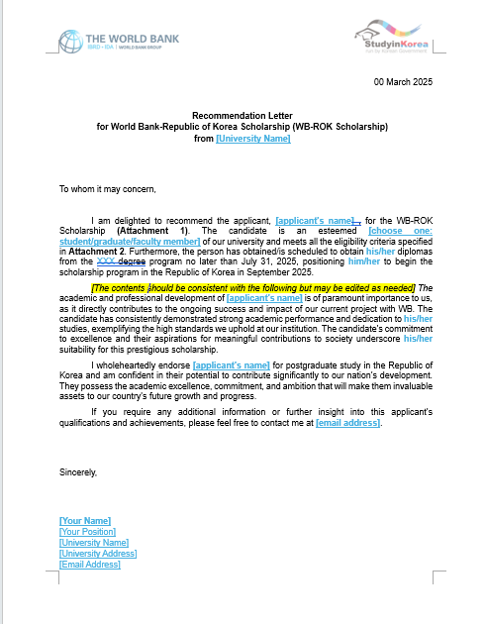
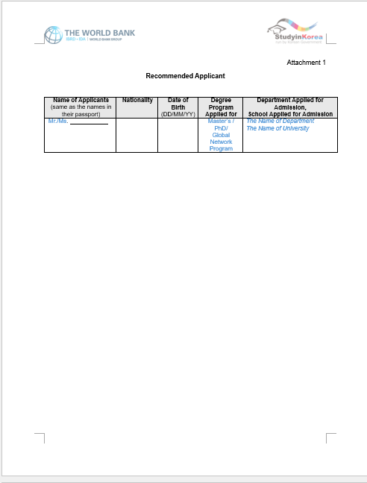
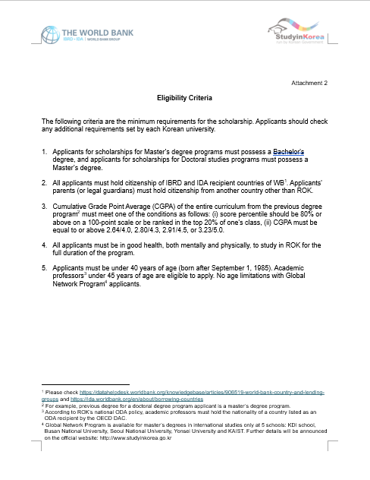
Required Documents
Required Documents – Letter of Recommendation
All WB-ROK Scholarship applicants should submit one recommendation letter from the WB Partner University and attach it as a part of the application package.
Link to the template : https://docs.google.com/document/d/1kknIu7cGb1tBi6VrbNoRVm0UT80SPXMC/edit?usp=sharing&ouid=102662323007126816817&rtpof=true&sd=true

Slide 14
Required Documents
Required Documents
All documents must be submitted in English or Korean
Documents written in English or Korean must be apostilled or consular confirmed.
Documents written in other languages:
1) must be submitted together with a certified translation in English or Korean,
2) must be apostilled or consular confirmed(either original document or certified
translation
Applicants submit one set of apostilled/consular confirmed documents directly to
the University they’re applying to.

Slide 15
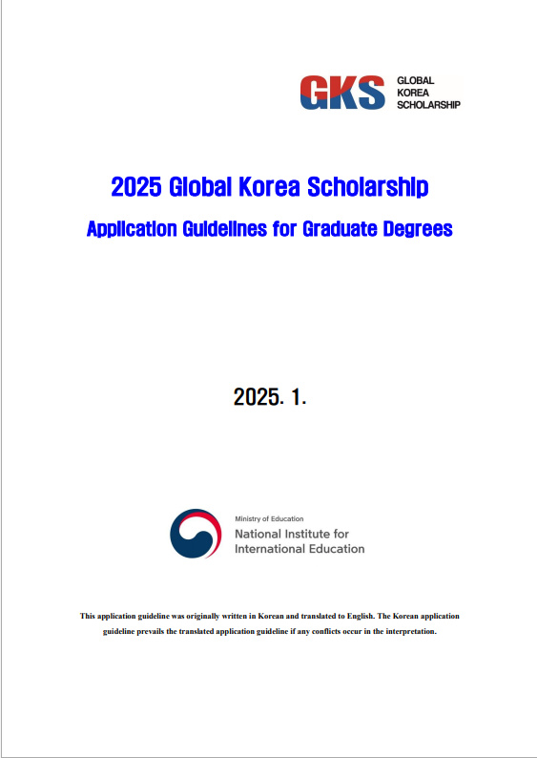
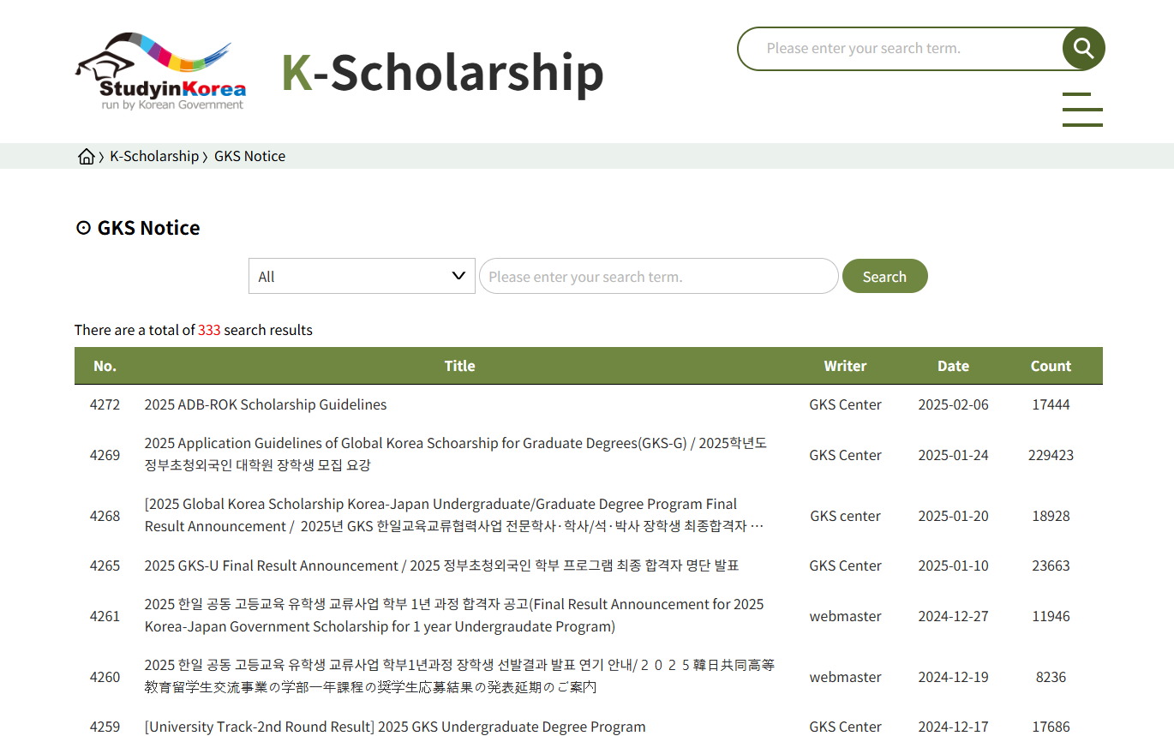
WB-ROK Program
Official announcement is on the website:
http://studyinkorea.go.kr > K-Scholarship > GKS
WB-ROK follows general official guidelines of the applications.
However, WB-ROK Scholarship specific information can be updated at the end-Feb / early March
For applicants,
Reading the official Application Guidelines is the most important step.

Slide 16
WB-ROK Program
Information Session
For more information, please register for an information session at 8am Coordinated Universal Time (UTC) (= 5pm in Korea)
on Friday, March 7, 2025
Please register in advance to attend the meeting on Zoom
https://renu.zoom.us/meeting/register/UTSAchrrRDm0u64FW8QbEQ

Slide 17
WB-ROK Program
Contact Information
https://www.studyinkorea.go.kr
(K-Scholarship - GKS Notice)
Inquiries regarding requirements/documents/eligibility:
gksniied@korea.kr
Inquiries regarding WB-ROK Scholarship - recommendation letter & procedure:
gkim3@worldbank.org

Slide 18
FAQs
FAQs: Application Procedure
Can the applicant apply to multiple universities?
  Applicants can only apply to one university and one department. If an applicant is found to have applied to more than two universities, their scholarship will be cancelled.
When is the deadline for the application?
  Each University has a different application period.
  Please check the website of each university.
May the applicant submit their application to WB?
  No. Applicants must submit their application documents directly to the university they are applying. Submission to WB or KMOE/NIIED will not be accepted. Any documents mistakenly sent to WB/KMOE/NIIED will be excluded from the screening and will not be returned.

Slide 19
FAQs
FAQs: Application Procedure
I’m expected to graduate from my current degree program in May of 2025. Am I eligible to apply for this program?
  Yes. Applicants who are expected to graduate by July 31st, 2025 can also apply for the program with a certificate of expected graduation. Such applicants must submit their official graduation certificate (or diploma) and final academic transcript to GKS Center, NIIED by July 31st, 2025. Failure to do so will result in the cancellation of your acceptance.
I have a master’s degree. Can I apply for a master’s degree program in a different major? Which degree certificate should I submit?
  You can apply for a master's program while holding another master's degree. If you are applying to a master’s degree program, you should submit a degree certificate and academic transcript of your bachelor's degree. In this case, your CGPA of your bachelor’s degree should meet the grade requirement in the application guidelines. Providing your master’s degree certificate and academic transcript is optional.

Slide 20
FAQs
FAQs: Application Procedure
I am applying for a doctoral degree program. Should I also submit a CGPA of my bachelor’s degree?
  Applicants for a doctoral degree program should put a CGPA of their previous degree (master’s degree) on the application form. Doctoral degree program applicants should submit the graduation certificate and official academic transcript of both bachelor’s and master’s degree. The CGPA required in the application is of the master’s degree.
When it comes to faculty members, is this opportunity open only to those who are currently employed?
  Yes, if you are applying as a faculty member, you must currently be a faculty member (former faculty are not eligible in this case).If you are a current academic professor with citizenship from one of the ODA recipient countries and are under 45, you are eligible to apply as a faculty member.
  All general students and graduates under the age of 40 and affiliated with a university engaged in a World Bank program activity are eligible to apply for the WB-ROK Scholarship.

Slide 21
FAQs
FAQs: Language course
Is it mandatory for all GKS scholars to pass at least Level 3 in TOPIK
after one year of Korean Language Program?
  Yes. Every GKS scholar (except scholars in Global Network program) must achieve at least Level 3 on TOPIK (Test of Proficiency in Korean) within a yearlong Korean language program to proceed to his or her degree program.
  In addition, certain university or department requires students to submit a valid TOPIK certificate of level 4 or higher. Scholars who applied to such department may not enter their degree program if they fail to achieve the required TOPIK certificate during a yearlong Korean language program.

Slide 22
FAQs
FAQs: Language course
The degree program I applied to is taught in English only. May I be exempt from the Korean Language Program?
  No. A yearlong Korean language program is an important part of the GKS program. (exception: Global Network Program)
  However, if you have already attained advanced level (Level 5 or 6) on TOPIK when applying for the program, you must submit your valid TOPIK certificate to be exempt from Korean language program. You will directly start your degree program from September 2025.
  If you attain TOPIK level 5 or 6 during the first 6 months of Korean language program, you will be exempt from the remaining 6-month language program, and you must start your degree program in the following semester (March, 2026).
  Current academic professors who are apply for an exemption from Korean language training in a 100% English-taught program will be exempted from the Korean Language program.

Slide 23
FAQs
FAQs: Required document
Whom should the applicant get a recommendation letter from?
- WB-ROK Scholarship applicant should get a recommendation letter from the
WB Partner university.
For the legalization on “Required certificates”, can I choose between apostille or consular confirmation?
  Countries that have joined the Apostille Convention, can only issue an apostille. For the rest of the countries, you should obtain consular confirmation from the Korean embassy/consulate in your country.
  If your country does not belong to the Apostille Convention or if the document cannot be apostilled, please obtain a consular confirmation from the Korean embassy/consulate.

Slide 24
FAQs
FAQs: Others
May I change my final university choice during my Korean language program or during a degree program?
  No. Changing the university or transferring to another university is NOT PERMITTED.

Slide 25

THANK YOU

